Slide 1



Document Retrieval
System
By Praneeth Reddy Vellaboyana
Notes:
To view this presentation, first, turn up your volume and second, launch the self-running slide show.

Slide 2
Information Retrieval
Traditionally, IR has concentrated on finding whole documents consisting of written text; much IR research focuses more specifically on text retrieval – the computerized retrieval of machine readable text without human indexing.

Slide 3
Problem STATEMENT
To simulate a document retrieval system to fetch and display the documents based on the rank.

Slide 4
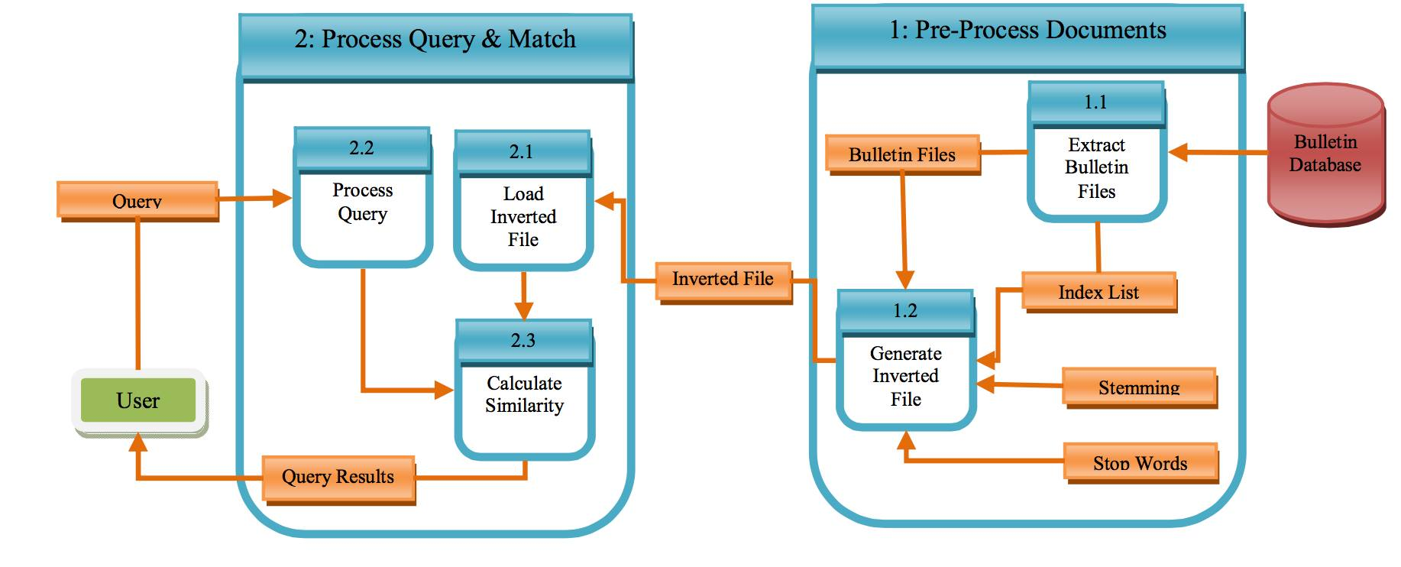
IMPLEMENTAION
Implemented Document Retrieval in two steps
Pre-Processing Documents
Query Processing, Matching and Ranking using BM25

Slide 5
Pre-processing documents
Tokenization
Stop word Removal
Stemming (Using Porter Stemmer)
Counting the token count for each document
Inverted Index and Token count using (TreeMap)
Object Streaming both inverted index and token count

Slide 6
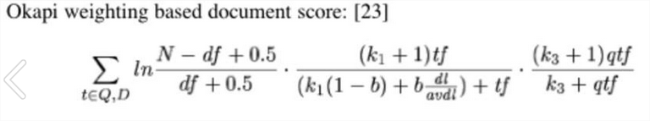
BM25 (Best matching 25)
Calculated the relevance using the Tf-Idf

Slide 7

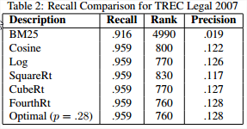
Algorithm
BM25
(k₃+1)q
(k₃+q) · (k₁+1)f
(K+f) ·log (r+0.5)(N-n-R+r+0.5)
(n-r+0.5)(R-r+0.5)
Notes:
…five simple rules for creating world-changing presentations.

